Slide 1

University of Barishal
Knowledge is power

Slide 2
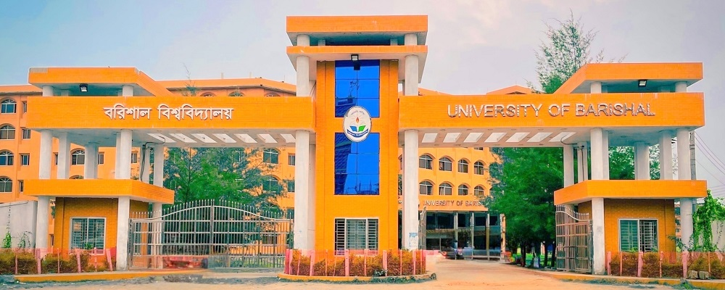
University of Barishal
The University of Barishal, established on February 24, 2011, is a prominent public university in southern Bangladesh. Situated along the tranquil Kirtankhola River, the campus is admired for its lush greenery and natural beauty, providing a serene environment for education. With modern facilities and a commitment to academic excellence, the university blends progress with picturesque charm, inspiring students to contribute to national development.

Slide 3
Income of University of Barishal
Income Source | Annual Income(BDT) | Percentage (%)
Government Grants | 50,000,000 | 60%
Tuition Fees | 20,000,000 | 24%
Research Grants | 5,000,000 | 6%
Donations and Endowments | 3,000,000 | 4%
Miscellaneous Income | 2,000,000 | 2%
Total | 80,000,000 | 100%

